Slide 1
PEARLS: Discovery of Point-Source Features Within Galaxies Throughout the North Ecliptic Pole Time Domain Field
Rafael Ortiz III
Mentors: Dr. Rogier Windhorst
Dr. Seth Cohen, Dr. Rolf Jansen
School of Earth and Space Exploration at ASU
April 20, 2024

Slide 2
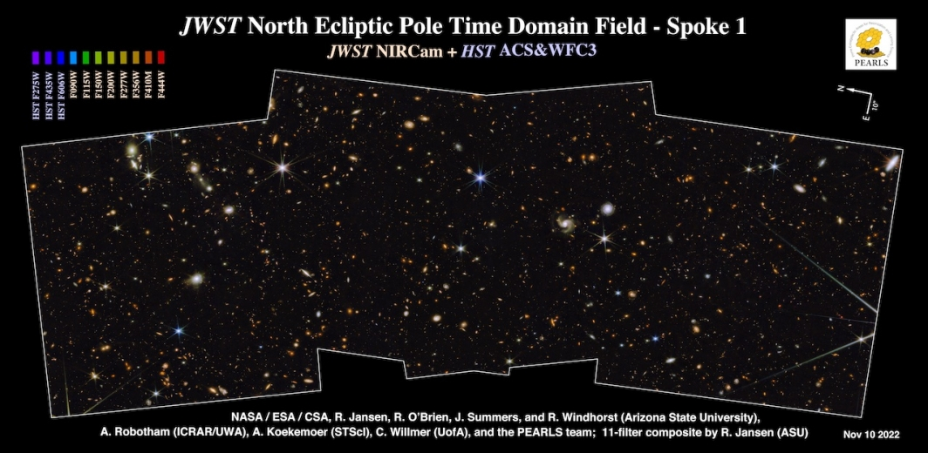
BACKGROUND

Slide 3
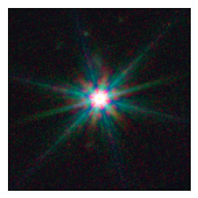
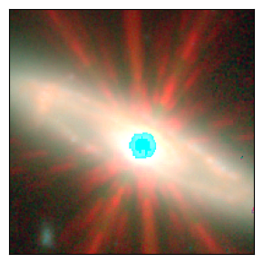
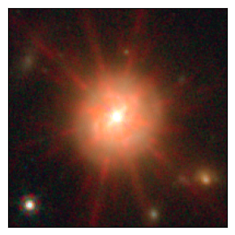
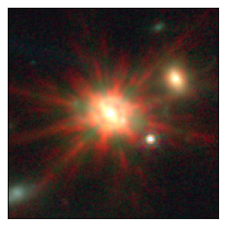
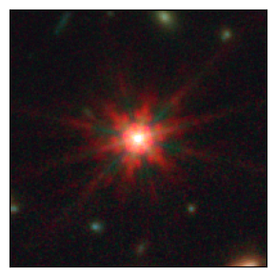
Motivation
STAR
Unresolved point-source features within resolved galaxies
Hypothesis:
Star-like features hint at an Active Galactic Nuclei (AGN)
GALAXY

Slide 4
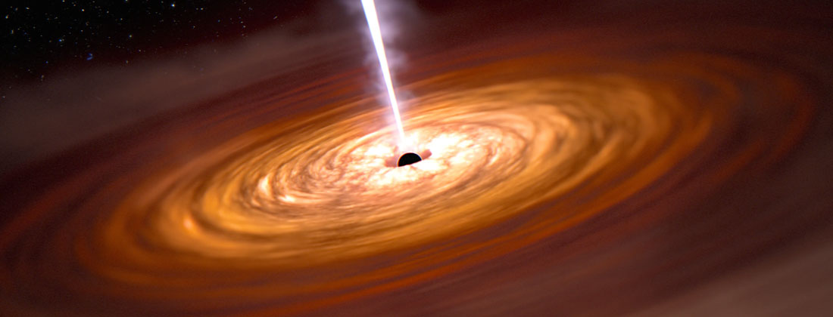
Active Galactic Nuclei
AGN are powerful sources of radiation fueled by supermassive black holes
Insights into cosmology and high energy physics
https://dark.nbi.ku.dk/research/black-holes/

Slide 5
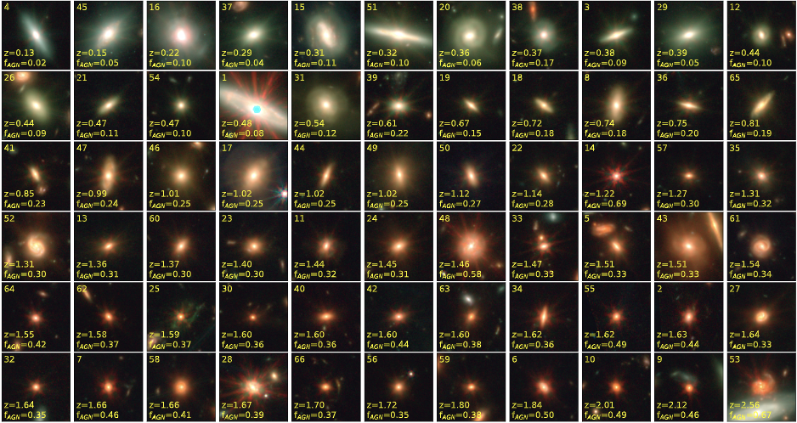

Slide 6
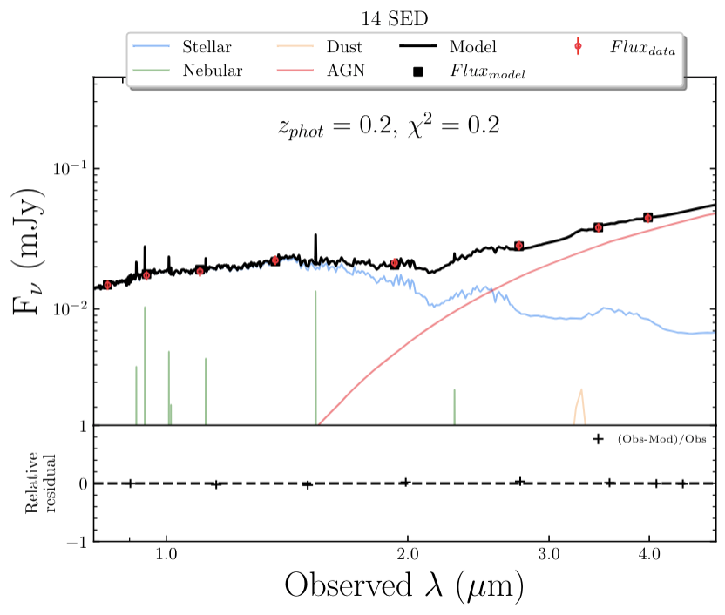
Methods - SED Fitting
Boquien et al. 2019
Infer physical properties & characterize our sample
We employ CIGALE¹ to fit the photometry from 0.9-4.4μm across 8 NIRCam filters

Slide 7
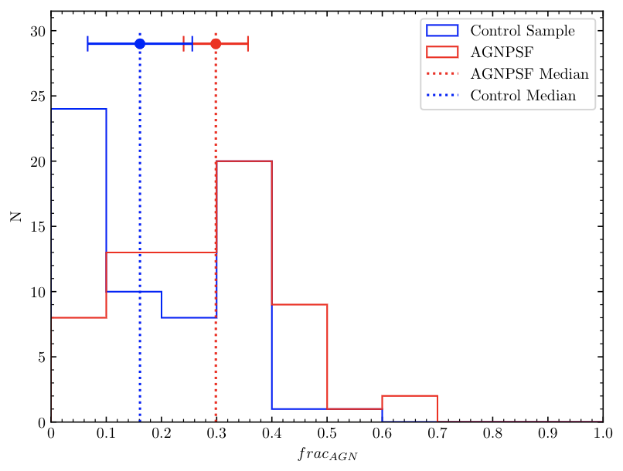
CIGALE
Interpolate > 1e6 models w/ stellar, dust, and AGN components
frac_{AGN}
AGNPSF
0.30 ± 0.06
Control
0.16 ± 0.09

Slide 8
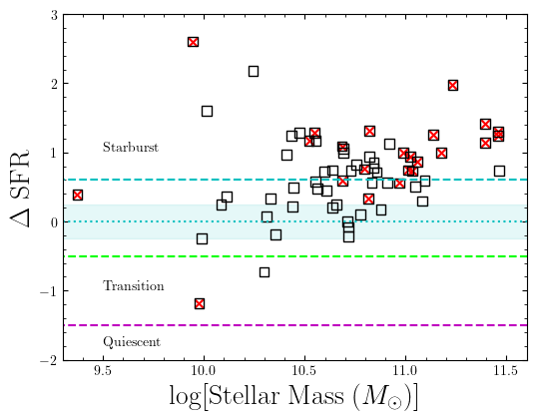
CIGALE
‹ M › ≈ 4.9 x 10¹⁰ M⦿
23 cross-correlations w/ VLA 3GHz catalogs
~40% of AGNPSF in Starburst region
Active in both AGN and Star-Formation
Simultaneous?

Slide 9
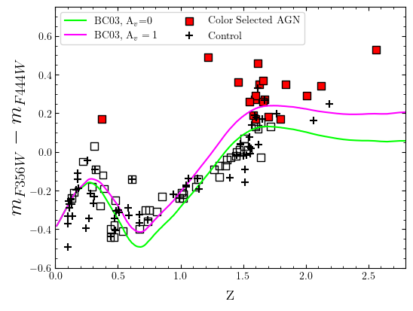
Colors
19 AGNPSF classified as AGN via color
W1 - W2 > 0.8
Seeing dust obscured AGN?

Slide 10
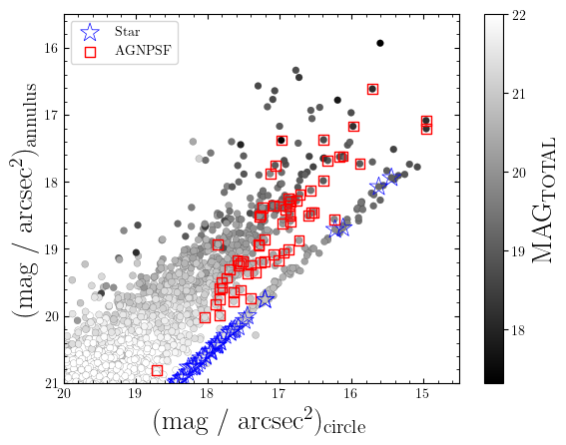
Automated AGNPSF Selection
Isolate AGNPSF from JWST NEP TDF via surface brightness & morphology
Robust star-AGNPSF separation & AGNPSF separation from bright galaxies

Slide 11
Conclusions
Our sample has SEDs characteristic of AGN
UV to Sub-mm photometry will improve frac_{AGN} constraints
Point source features dominate the reddest filters
Potentially dusty torus / reprocessed radiation from dust
Radio sources could be emission from AGN or synchrotron radiation from stellar remnants of Type II Supernovae
Our novel procedure in aperture photometry automatically recovers our sample and identifies galaxy candidates that could have point-source features to be used in any JWST NIRCam image

Slide 12
Acknowledgements
All glory to God!
Dr. Rogier Windhorst, Dr. Seth Cohen, Dr. Rolf Jansen
ASU/NASA Space Grant
PEARLS Team
School of Earth and Space Exploration

Slide 13
Thanks!
rortizii@asu.edu

